Slide 1
Quantitative Management Modelling Group Presentation Title : Shipping & Transportation Analysis
MSBA (2019-2020) Semester-1
Group Submission
Instructor: Prof. Chaojiang (CJ) Wu
Submitted by:
Sai Sumanth
Sushmita
Sharmili

Slide 2
AGENDA
Problem Statement
Method
Network Diagram
Objective Function
Constraints
R Implementation
Optimal Solution
Future Scope

Slide 3

PROBLEM STATEMENT
Rachel Sundusky is the manager of Stateline Shipping and Transport Company. She signed a contract with Polychem, a company that manufactures chemicals for industrial use.
Polychem wants Stateline to pick up and transport waste products from its six plants to three waste disposal sites.
In addition to shipping directly from each of the six plants to one of the three waste disposal sites, Rachel is also considering using each of the plants and waste disposal sites as intermediate shipping points. Trucks would be able to drop a load at a plant or disposal site to be picked up and carried on to the final destination by another truck, and vice versa.
She particularly wants to know if it would be cheaper to ship directly from the plants to the waste sites or if she should drop and pick up some loads at the various plants and waste sites.

Slide 4
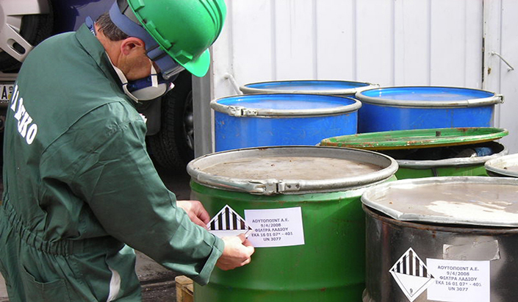

Additional information
The chemical wastes that will be hauled can be hazardous to humans and the environment if they leak. In addition, a number of towns and communities in the region where the plants are located prohibit hazardous materials from being shipped through their municipal limits. Thus, not only will the shipments have to be handled carefully and transported at reduced speeds, they will also have to traverse circuitous routes in many cases.

Slide 5

Method
What would be the appropriate method that give us the optimal solution which results in minimum transportation cost?

Slide 6
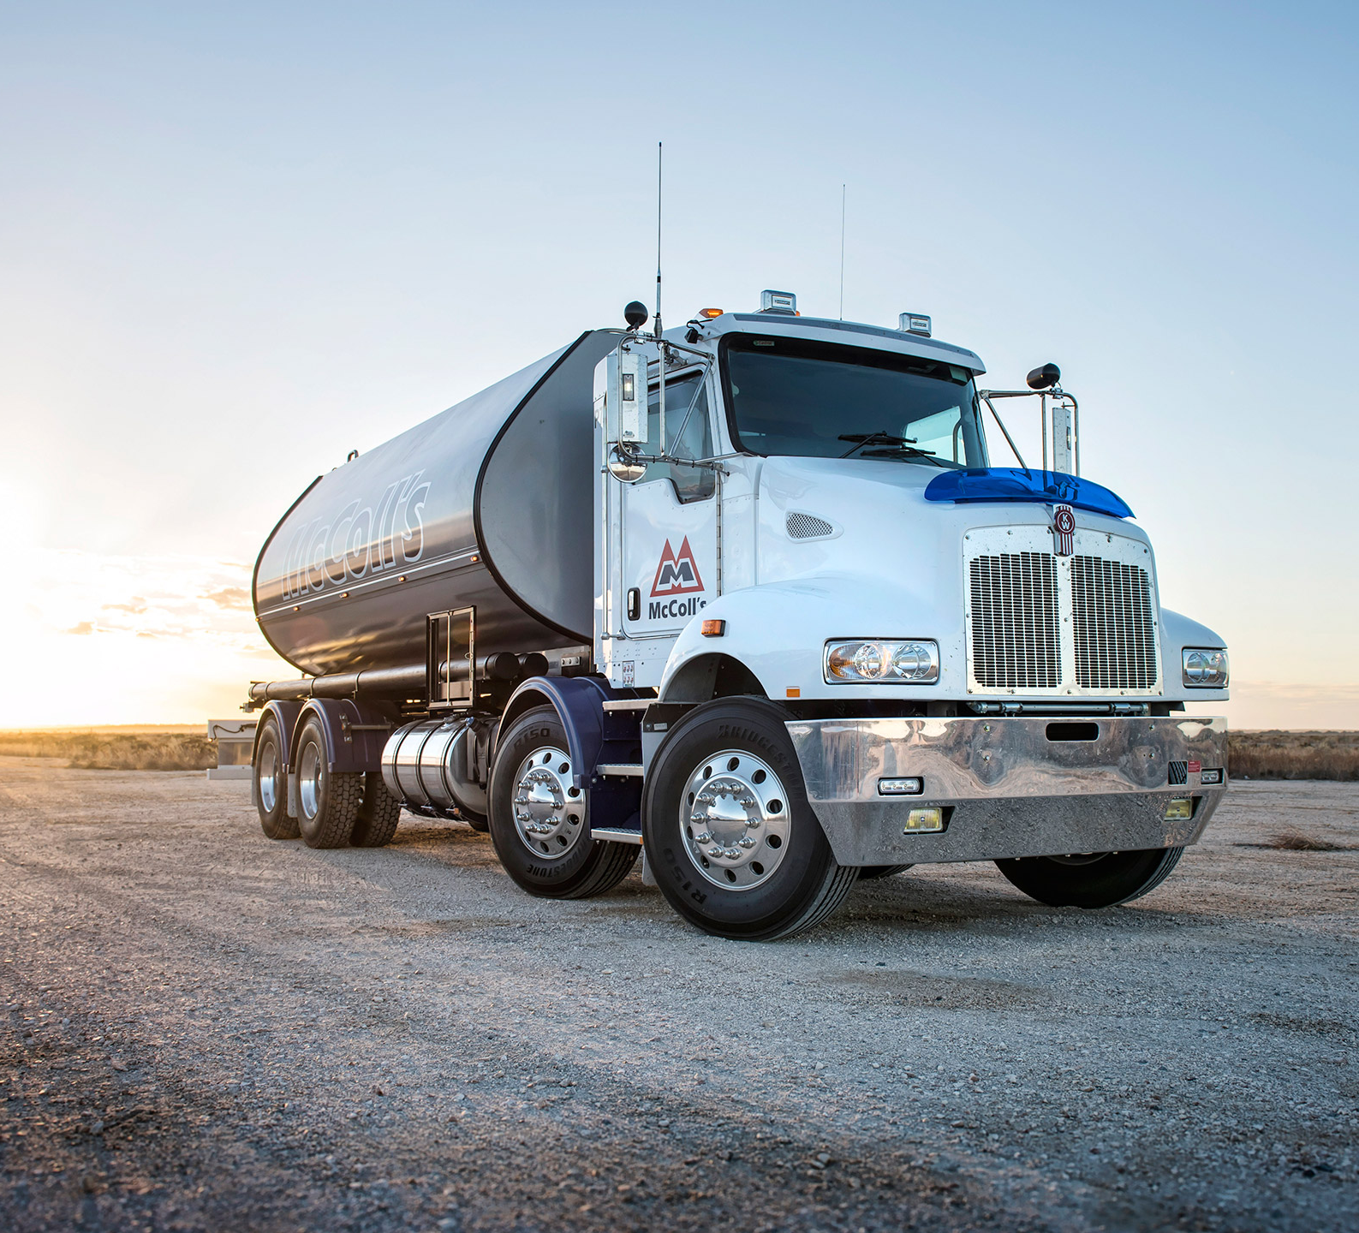
Transportation & Transshipment Model based problem by Using LPSolver.

Slide 7
APPROACHES
Our aim is to construct a model by considering the optimal approaches that would minimize the cost.
Considering using each of the plants and waste disposal sites as intermediate shipping points
Trucks would be able to drop a load at a plant or disposal site to be picked up and carried on to the final destination by another truck, and vice versa.
Waste products can be shipped directly from waste disposal sites to each of six plants

Slide 8

Transportation Problem Description
Transportation problem deals with the distribution of goods from sources to destination.
It aims to find the best way to fulfill the demand using the capacity of supply points.
We are trying to find the optimal approach to minimize cost of shipping the product from one supply point to a demand point.

Slide 9
Transportation Problem Formulation
The six plants will be considered as supply sources and three waste disposal sites are to be considered as destination.
In transportation problem, Shipments will be shipped directly from each plant to waste disposal sites.
Our goal is to determine the optimal shipping route that will minimize Stateline company’s total cost.

Slide 10
Supply table
Plant | Waste per Week (bbl)
Kingsport | 35
Danville | 26
Macon | 42
Selma | 53
Columbus | 29
Allentown | 38
Each of the plants generate the following amounts of waste products each week:

Slide 11
Transportation table
Plant | Waste Disposal Site
 | Whitewater | Los Canos | Duras
Kingsport | $12 | $15 | $17
Danville | 14 | 9 | 10
Macon | 13 | 20 | 11
Selma | 17 | 16 | 19
Columbus | 7 | 14 | 12
Allentown | 22 | 16 | 18
The transportation table expresses the supply and demand constraints and the shipping cost between each demand and supply points.
The three waste disposal sites at Whitewater, Los Canos, and Duras can accommodate a maximum of 65, 80, and 105 barrels per week respectively.
Demand

Slide 12
Balanced Transportation Problem
If total supply equals to total demand, the problem is said to balanced transportation problem
Unbalanced Transportation problem
If total supply exceeds total demand or vise versa we can balance the problem by adding dummy demand point or supply point, they are assigned a cost of zero.
Since, we have demand more that total supply we have to add dummy variables to supply side.

Slide 13
[35]
1
Kingsport
[26]
2
Danville
A
[65]
[42]
3
Whitewater
Macon
[53]
4
Plants
B
[80]
Disposal Sites
Selma
Los Canos
[29]
5
Columbus
C
[105]
[38]
6
Duras
Allentown
[27]
7
Dummy

Slide 14
Mathematical Formulation
Decision Variable:
Since we have to determine how much waste is send from each plant to destination point
X_{ij} = The quantities of waste disposed from plant to disposed sites
Where,
i= 1,2,3,4,5,6,7 and j= A,B,C

Slide 15
OBJECTIVE FUNCTION
Since we want to minimize the total cost of shipping from plant to disposal sites, the objective function would be
Minimum Z: 12 x_{1A} + 15 x_{1B} + 17 x_{1C} + 14 x_{2A} + 9 x_{2B} + 10 x_{2C} + 13 x_{3A} + 20 x_{3B} + 11 x_{3C} + 17 x_{4A} + 16 x_{4B} + 19 x_{4C} + 7 x_{5A} + 14 x_{5B} + 12 x_{5C} + 22 x_{6A} + 16 x_{6B} + 18 x_{6C} + 0 x_{7A} + 0 x_{7B} + 0 x_{7C};

Slide 16
CONSTRAINTS
x_{1A} + x_{1B} + x_{1C} = 35;
x_{2A} + x_{2B} + x_{2C} = 26;
x_{3A} + x_{3B} + x_{3C} = 42;
x_{4A} + x_{4B} + x_{4C} = 53;
x_{5A} + x_{5B} + x_{5C} = 29;
x_{6A} + x_{6B} + x_{6C} = 38;
x_{7A} + x_{7B} + x_{7C} = 27;
x_{1A} + x_{2A} + x_{3A} + x_{4A} + x_{5A} + x_{6A} + x_{7A} = 65;
x_{1B} + x_{2B} + x_{3B} + x_{4B} + X_{5B} + x_{6B} + x_{7B} = 80;
x_{1C} + x_{2C} + x_{3C} + x_{4C} + x_{5C} + x_{6C} + x_{7C} = 105;
Supply Constraints
Demand Constraints

Slide 17
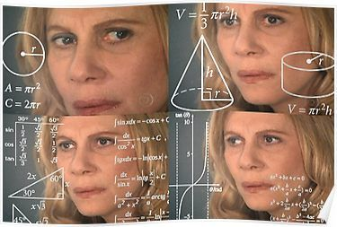
Too many variables to estimate?

Slide 18
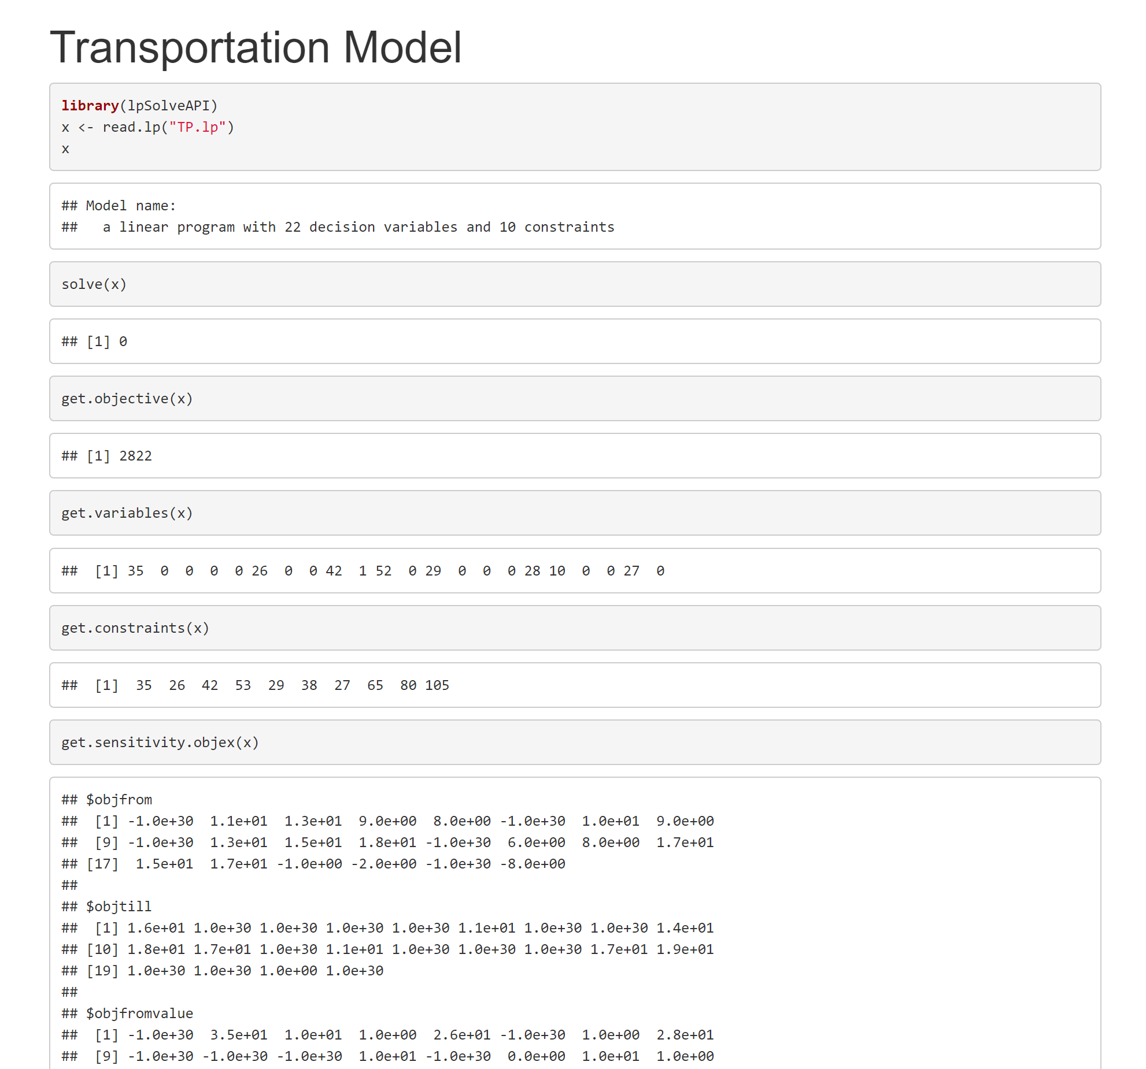

R- Implementation

Slide 19
[35]
1
Kingsport
[26]
2
Danville
A
[65]
[42]
3
Whitewater
Macon
4
1
[53]
52
B
Plants
[80]
Disposal Sites
Selma
Los Canos
[29]
5
Columbus
28
C
[105]
[38]
6
10
Duras
Allentown
[27]
7
Dummy

Slide 20
If we go by the above optimal path, the total transportation cost would be
$2822

Slide 21
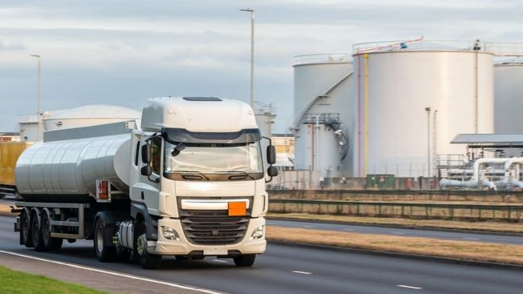
Transshipment Problem Description
Transshipment problem is an extension of transportation problem.
In this, we are considering intermediate nodes between sources and destinations.
The better analogy that explain transshipment model would be a warehouse where shipment arrives from factories and then leave for retail outlets.

Slide 22
The shipping costs per barrel between each of the six plants is presented in the table:
Plant | Plant
 | Kingsport | Danville | Macon | Selma | Columbus | Allentown
Kingsport | $ __ | $6 | $4 | $9 | $7 | $8
Danville | 6 | __ | 11 | 10 | 12 | 7
Macon | 5 | 11 | __ | 3 | 7 | 15
Selma | 9 | 10 | 3 | __ | 3 | 16
Columbus | 7 | 12 | 7 | 3 | __ | 14
Allentown | 8 | 7 | 15 | 16 | 14 | __

Slide 23
The estimated shipping cost per barrel between each of the three waste disposal sites is as follows:
Waste Disposal Site | Waste Disposal Site
 | Whitewater | Los Canos | Duras
Whitewater | $__ | $12 | $10
Los Canos | 12 | __ | 15
Duras | 10 | 15 | __

Slide 24
Mathematical Formulation
Decision Variable:
Since we have to determine how much waste is send from each plant to destination point via intermediate node
X_{ij} , X_{jk}= The quantities of waste disposed from plant to disposed sites
Where,
i= 1,2,3,4,5,6,7 , j= 1,2,3,4,5,6,7,A,B,C and k= A,B,C

Slide 25
1
1
[35]
Kingsport
Kingsport
2
[26]
2
Danville
Danville
3
A
[65]
[42]
3
Macon
Whitewater
4
Macon
Selma
[53]
4
5
B
[80]
Selma
Columbus
Los Canos
6
[29]
5
Allentown
Columbus
C
A
[105]
[38]
6
Duras
Whitewater
Allentown
B
[27]
7
Los Canos
C
Dummy
Duras

Slide 26
Objective Function
Min Z : 6X₁₂ + 4X₁₃ + 9X₁₄ + 7X₁₅ + 8X₁₆ + 6X₂₁ + 11X₂₃ + 10X₂₄ + 12X₂₅ + 7X₂₆ + 5X₃₁ + 11X₃₂ + 3X₃₄ + 7X₃₅ + 15X₃₆ + 9X₄₁ + 10X₄₂ + 3X₄₃ + 3X₄₅ + 16X₄₆ + 7X₅₁ + 12X₅₂ + 7X₅₃ + 3X₅₄ + 14X₅₆ + 8X₆₁ + 7X₆₂ + 15X₆₃ + 16X₆₄ + 14X₆₅ + 12X_{1A} + 15X_{1B} + 17X_{1C} + 14X_{2A} + 9X_{2B} + 10X_{2C} + 13X_{3A} + 20X_{3B} +11X_{3C} + 17X_{4A} + 16X_{4B} + 19X_{4C} + 7X_{5A} + 14X_{5B} + 12X_{5C} + 22X_{6A} + 16X_{6B} + 18X_{6C} + 12X_{AB} + 10X_{AB} + 12X_{BA} + 15X_{BC} + 10X_{CA} + 10X_{CB};

Slide 27
Constraints
X12 + X13 + X14 + X15 + X16 = 35;
X21 + X23 + X24 + X25 + X26 = 26;
X31 + X32 + X34 + X35 + X36 = 42;
X41 + X42 + X43 + X45 + X46 = 53;
X51 + X52 + X53 + X54 + X56 = 29;
X61 + X62 + X63 + X64 + X65 = 38;
X71 + X72 + X73 + X74 + X75 + X76 = 27;
Supply Constraints

Slide 28
X21 + X31 + X41 + X51 + X61 + X71 = X1A + X1B + X1C;
X12 + X32 + X42 + X52 + X62 + X72 = X2A + X2B + X2C;
X13 + X23 + X43 + X53 + X63 + X73 = X3A + X3B + X3C;
X14 + X24 + X34 + X54 + X64 + X74 = X4A + X4B + X4C;
X15 + X25 + X35 + X45 + X65 + X75 = X5A + X5B + X5C;
X16 + X26 + X36 + X46 + X56 + X76 = X6A + X6B + X6C;
X1A + X2A + X3A + X4A + X5A + X6A + XBA + XCA = 65;
X1B + X2B + X3B + X4B + X5B + X6B + XAB + XCB = 80;
X1C + X2C + X3C + X4C + X5C + X6C + XAC + XBC = 105;
Intermediate Nodes constraints
Demand Constraints

Slide 29
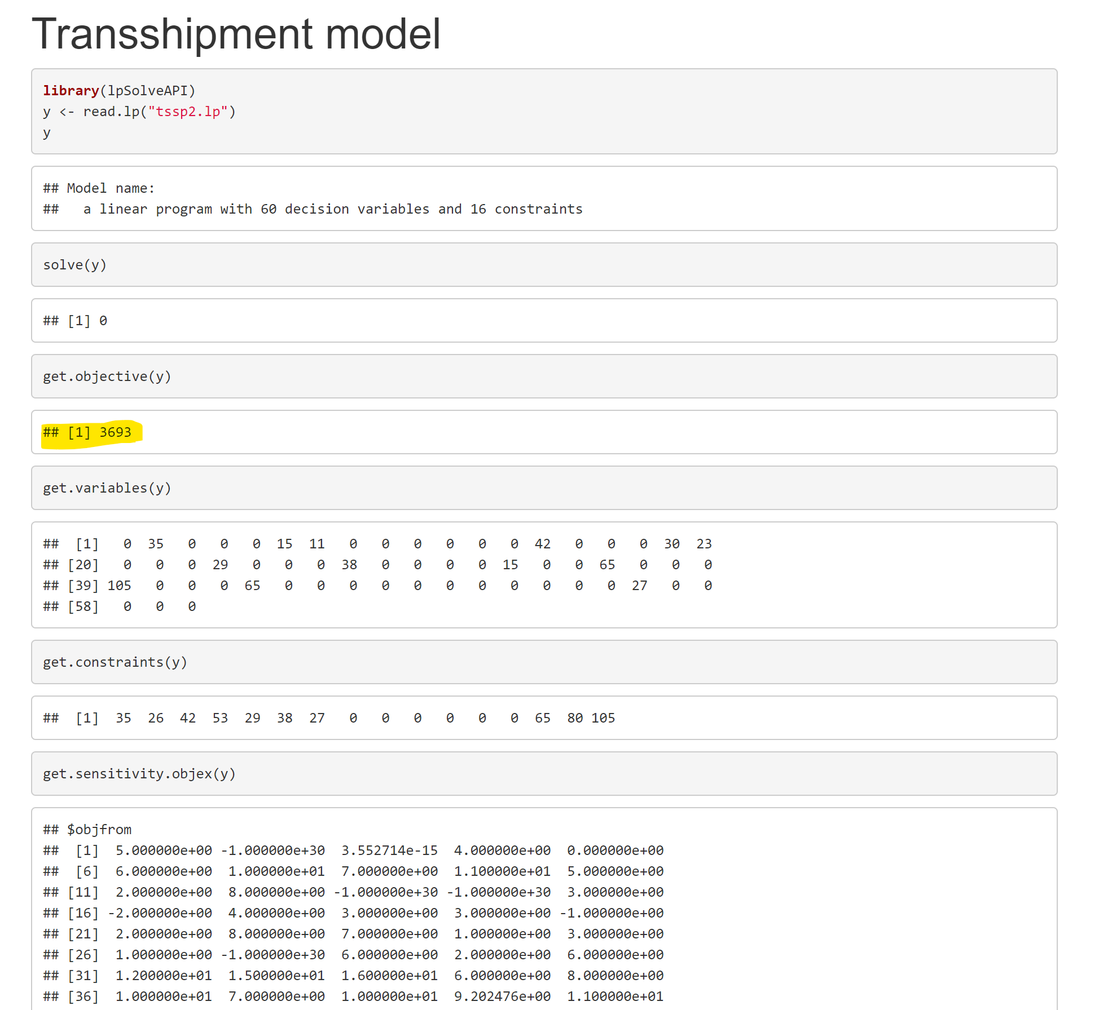

Slide 30
1
1
[35]
Kingsport
Kingsport
2
[26]
2
Danville
Danville
3
A
[65]
[42]
3
Macon
Whitewater
4
Macon
Selma
[53]
4
5
B
[80]
Selma
Columbus
Los Canos
6
[29]
5
Allentown
Columbus
C
A
[105]
[38]
6
Duras
Whitewater
Allentown
B
[27]
7
Los Canos
C
Dummy
Duras

Slide 31
If we go by the above optimal path, the total transportation cost would be
$3693

Slide 32
Conclusion
The Transportation problem of the Stateline Shipping and Transport Company was mathematically modelled and analysed.
The minimum cost of the company was estimated as $2822.
It is found that if we use certain intermediate points to drop the waste and then pick up from there to the final destination will increase the cost to the company i.e., $3693.
Hence, The transportation model would be preferable over transshipment model.

Slide 33

Any Questions?

